Slide 1
Switch Statement
Computer Science: A Structured Programming Approach Using C

Slide 2
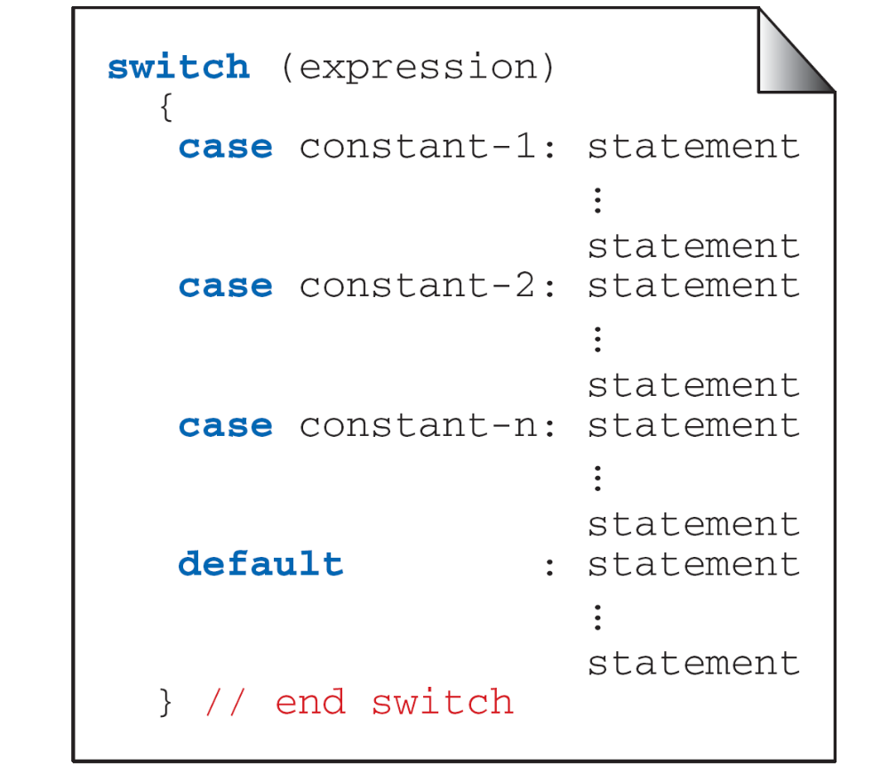
FIGURE 5-20 switch Statement Syntax
Computer Science: A Structured Programming Approach Using C

Slide 3
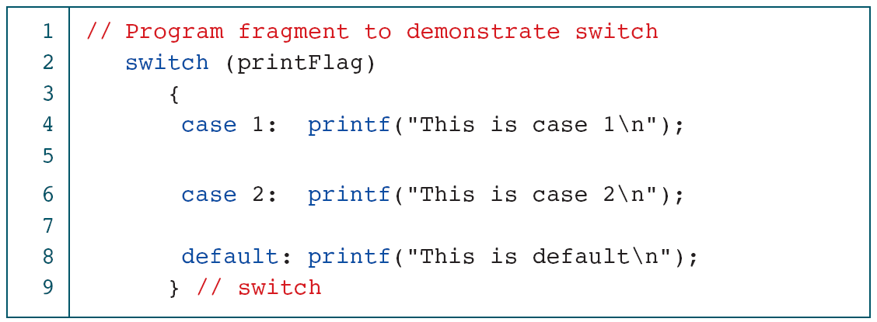
PROGRAM 5-6
Demonstrate the switch Statement
Computer Science: A Structured Programming Approach Using C

Slide 4
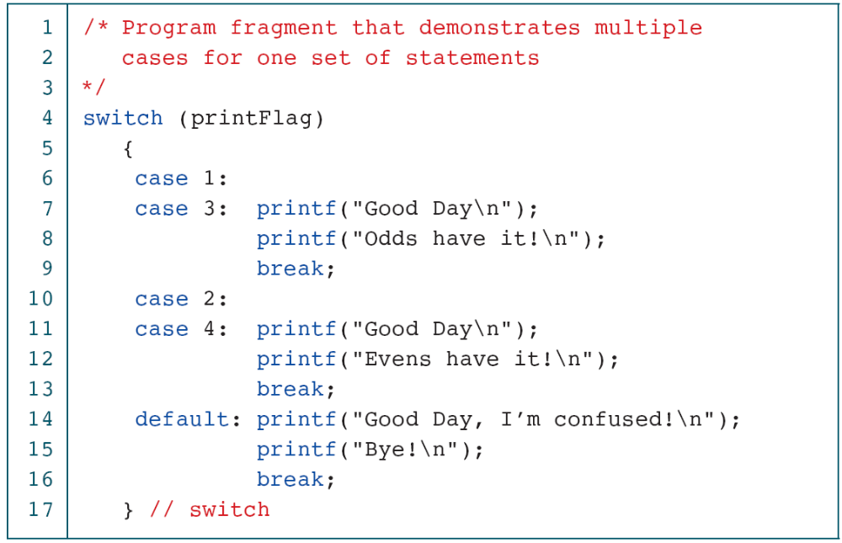
PROGRAM 5-7
Multivalued case Statements
Computer Science: A Structured Programming Approach Using C

Slide 5
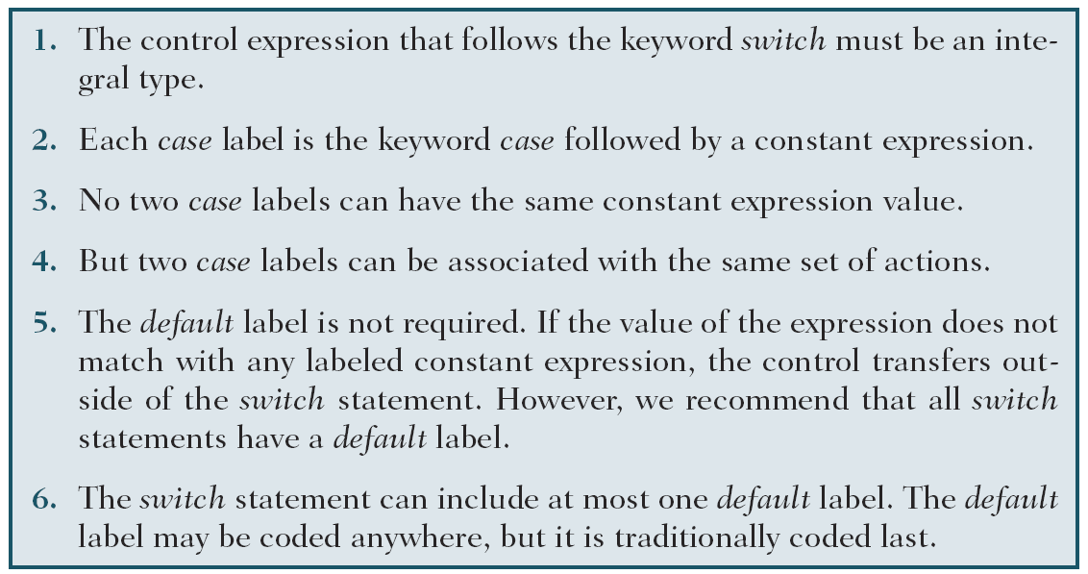
Table 5-5
Summary of switch Statement Rules
Computer Science: A Structured Programming Approach Using C

Slide 6
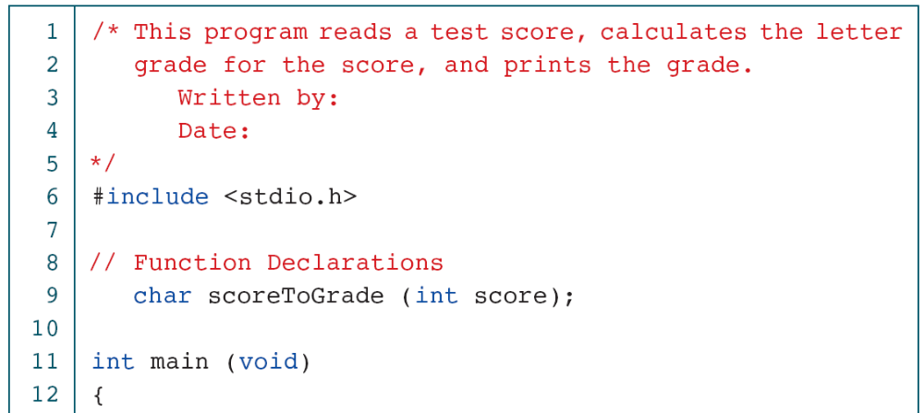
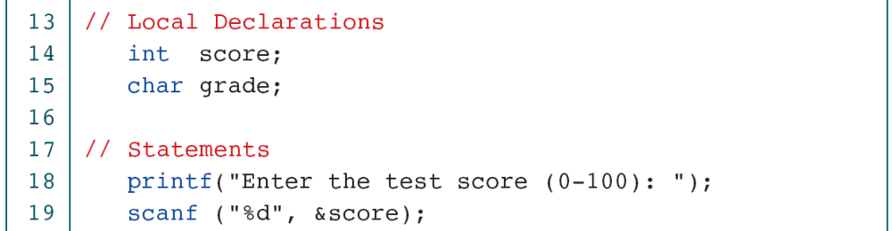
PROGRAM 5-8
Student Grading
Computer Science: A Structured Programming Approach Using C

Slide 7
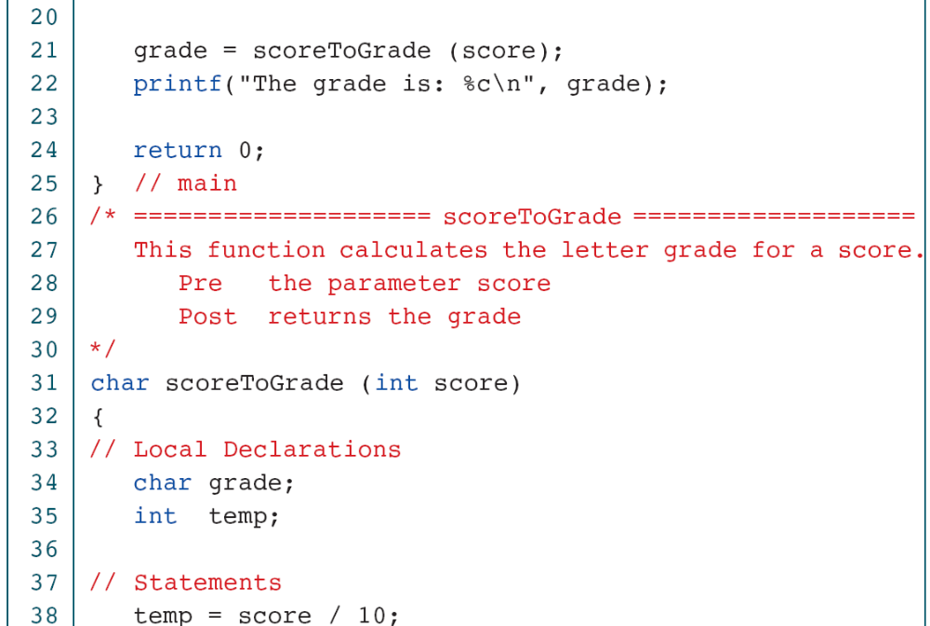
PROGRAM 5-8
Student Grading
Computer Science: A Structured Programming Approach Using C

Slide 8
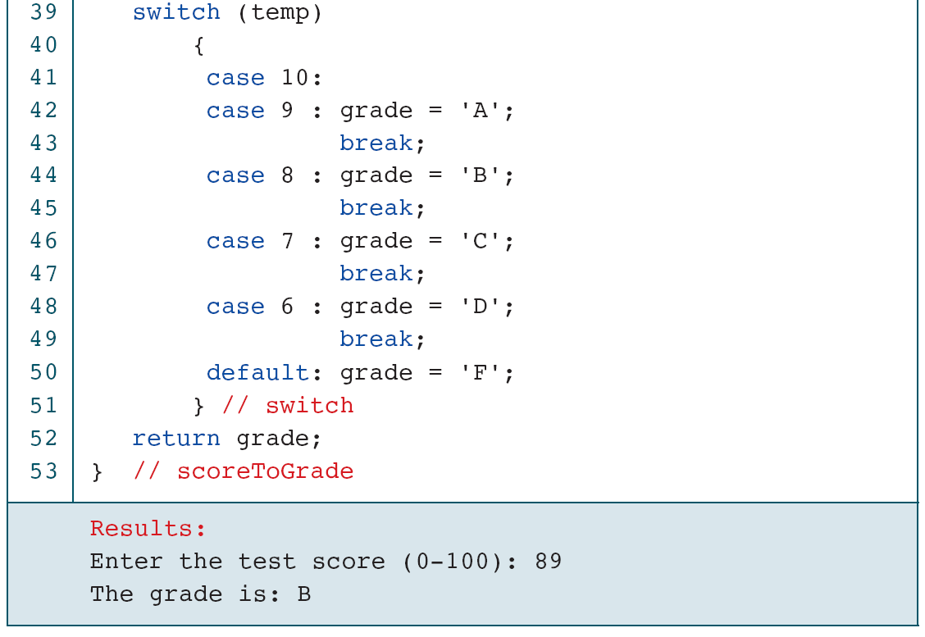
PROGRAM 5-8
Student Grading
Computer Science: A Structured Programming Approach Using C

